Slide 1

VRINDA STORE ANALYSIS

Slide 2
🎯Project Objective
The Vrinda Store aims to analyze its annual sales report for 2022 to gain valuable insights into customer behavior and improve sales performance for 2023 & 2024. The objective is to identify key trends, understand purchase patterns, and optimize marketing strategies to drive revenue growth.

Slide 3
❓📈Questions:
Compare the sales and orders using single chart.
Which Month got the highest sales and orders?.
Who purchased more Men or Women?.
What are different order status in 2022?.
List top 10 states contributing to the sales?.
Relation between Age and Gender based on number of orders.
Which channel is contributing maximum to the sales?.
Highest selling category?.
Percentage of total orders delivered.
Dashboard interaction

Slide 4
1. Compare the sales and orders using single chart.

Slide 5
2. Which month got the highest sales and orders?
March month got the highest sales and orders

Slide 6
3.Who purchased more- Men or Women?

Slide 7
4. What are different order status in 2022?

Slide 8
5. List top 10 states contributing to the sales?

Slide 9
6. Relation between Age and Gender based on number of orders.

Slide 10
7. Which channel is contributing maximum to the sales?

Slide 11
9. Percentage of total orders delivered

Slide 12
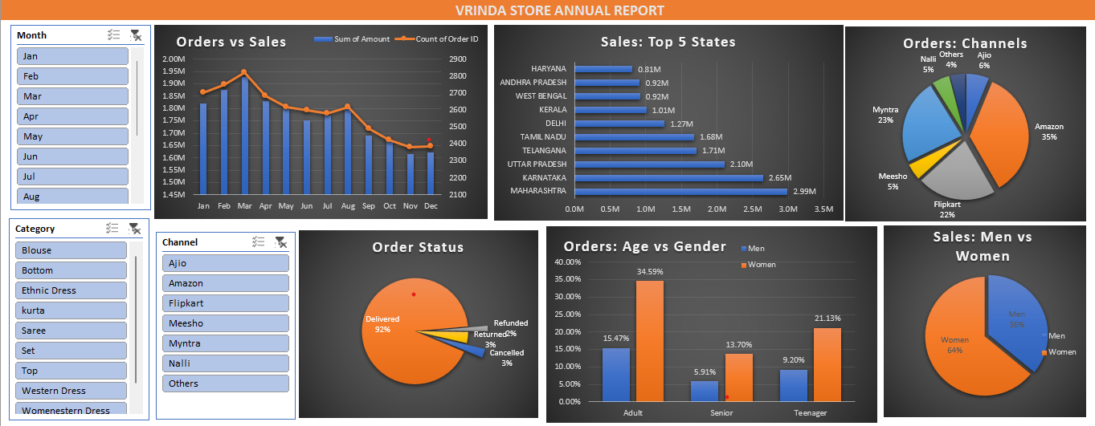
10. DASHBOARD

Slide 13
🔍Process
✅ Handling Missing Values & Anomalies.
-Checked for null, duplicate, and inconsistent values in the dataset.
✅ Ensuring Data Consistency.
-Verified and standardized data types (e.g., date formats, numerical values).
✅ Creating Pivot Tables.
-Built pivot tables based on key business questions
✅ Merging Pivot Tables into a Dynamic Dashboard.
-Combined all pivot tables into a single interactive dashboard.
-Applied slicers and filters for real-time analysis and better insights.

Slide 14
📊Project insight:
Women customers are the primary buyers – Around 65% of total purchases were made by women, indicating a strong female customer base.
Top-performing states – Maharashtra, Karnataka, and Uttar Pradesh contributed to approximately 35% of total sales, making them the key markets.
Age group impact – The 30-49 years age group accounted for 50% of total orders, highlighting the most engaged customer segment.
Leading sales channels – Amazon, Flipkart, and Myntra contributed nearly 80% of total sales, proving their dominance in driving revenue.
Best-selling categories – Certain product categories outperformed others, making them ideal for promotions and stock prioritization.
Delivery efficiency – A high percentage of orders were successfully delivered, showcasing strong logistics and customer fulfillment.

Slide 15
🏆Conclusion:
✅ To maximize future sales, Vrinda Store should focus on women customers (30-49 years) in Maharashtra, Karnataka, and Uttar Pradesh while leveraging Amazon, Flipkart, and Myntra for targeted promotions, ads, and personalized offers.

Slide 16

Thank you….

